Slide 1

CSC2231 COMPUTER ARCHITECTURE
Lecture slides 1

Slide 2


Outline
UNIVERSITY, KANO
www.buk.edu.ng
Basic concepts
Brief Historical Overview
Stored program (von Neumann) computer organisation
Instruction Sets
Processor Cycle
Measuring, predicting, and improving performance
Inside the CPU
Basic Device Physics
Boolean Algebra and Digital Logic
Implementing CPU elements with Digital Logic
Pipelining
Controlling the CPU
www.buk.edu.ng
2

Slide 3
Outline
UNIVERSITY, KANO
www.buk.edu.ng
Memory Architecture
Memory Design and Construction
The Memory Hierarchy
The Memory Map
Caches
I/O and Peripheral Control
Buses
Memory-mapped I/O
Interrupts
Direct Memory Access
Hardware/Software Interface
What happens during compilation and linking?
Machine Code and Assembly Language
Generating Code
Addressing Modes
www.buk.edu.ng
3

Slide 4
Reference Texts
UNIVERSITY, KANO
www.buk.edu.ng
Title | Author(s) | Publisher, Date
Computer Organization, Design, and Architecture | Sajjan G. Shiva | CRC Press, 2014
Computer organization and Design - The Hardware/Software Interface | John Hennessy and David Patterson | Morgan Kaufmann, 2009
Structured Computer Organization | Andrew Tanenbaum and Tood Austin | Pearson Education, 2013
Schaum’s Outline: Computer Architecture | Nicholas Carter | McGraw Hill, 2002
Computer Architecture: A Quantitative Approach | John Hennessy and David Patterson | Morgan Kaufmann, 2011
Computer Organization and Architecture | William Stallings | Pearson Education, 2013
BUK/CS/2014/L2Sem1/Baffa
www.buk.edu.ng
4

Slide 5

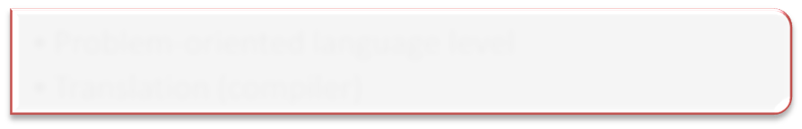









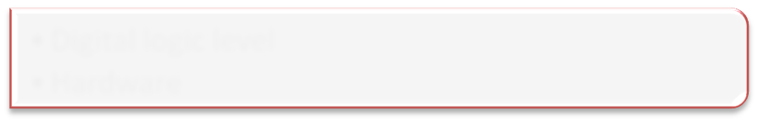


What is Computer Architecture?
UNIVERSITY, KANO
www.buk.edu.ng
Can be defined at different levels:
Problem-oriented language level
Level 7
Translation (compiler)
Assembly Language level
Translation (assembler)
Level 6
Operating system machine level
Partial interpretation (OS)
Level 5
Instruction Set Architecture level
Interpretation or Direct execution (Microprogram)
Level 4
Micro architecture level
Hardware
Level 3
Digital logic level
Hardware
Level 2
Device Level
Level 1
www.buk.edu.ng

Slide 6
What is Computer Architecture
UNIVERSITY, KANO
www.buk.edu.ng
Levels 1, 3 and 4 will be our main preoccupation
Why do we bother with all these?
In order to do:
Tell us how computer are built
How the computer operates
Knowing what's inside and how it works
help you design, develop, and implement applications better, faster, cheaper, more efficient, and easier to use because you will be able to make informed decisions
Be a good Computer Scientist
Understands how computer processes information
www.buk.edu.ng

Slide 7
What is Computer Architecture?
In describing computers, a distinction is often made between computer architecture and computer organization.
Computer architecture refers to those attributes of a system visible to a programmer, those attributes that have a direct impact on the logical execution of a program. A term that is often used interchangeably with computer architecture is instruction set architecture (ISA). The ISA defines instruction formats, instruction opcodes, registers, instruction and data memory; the effect of executed instructions on the registers and memory; and an algorithm for controlling instruction execution.
Computer organization refers to the operational units and their interconnections that realize the architectural specifications.

Slide 8
Computer Architecture
STRUCTURE AND FUNCTION
A computer is a complex system; contemporary computers contain millions of elementary electronic components. How, then, can one clearly describe them?
Structure: The way in which the components are interrelated.
Function: The operation of each individual component as part of the structure.

Slide 9
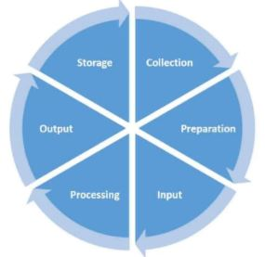
Function
There are four (4) basic Function that a computer can perform
Data processing: Data may take a wide variety of forms, and the range of processing requirements is broad. However, we shall see that there are only a few fundamental methods or types of data processing.
Data Processing Cycle : The data processing cycle consists of a series of steps where raw data (input) is fed into a process (CPU) to produce actionable insights (output). Each step is taken in a specific order.

Slide 10
Data Processing Cycle
Collection: The collection of raw data is the first step of the data processing cycle. The type of raw data collected has a huge impact on the output produced.
Preparation: Data preparation or data cleaning is the process of sorting and filtering the raw data to remove unnecessary and inaccurate data. Raw data is checked for errors, duplication, miscalculations or missing data, and transformed into a suitable form for further analysis and processing
Input: In this step, the raw data is converted into machine readable form and fed into the processing unit. This can be in the form of data entry through a keyboard, scanner or any other input source.

Slide 11
Data Processing Cycle
Data Processing: In this step, the raw data is subjected to various data processing methods using machine learning and artificial intelligence algorithms to generate a desirable output.
Output: The data is finally transmitted and displayed to the user in a readable form like graphs, tables, vector files, audio, video, documents, etc. This output can be stored and further processed in the next data processing cycle.
Storage: The last step of the data processing cycle is storage, where data and metadata is stored for further use. This allows for quick access and retrieval of information whenever needed, and also allows it to be used as input in the next data processing cycle directly.

Slide 12
Types of Data Processing
There are different types of data processing based on the source of data and the steps taken by the processing unit to generate an output.
Batch Processing: Data is collected and processed in batches. Used for large amounts of data. Eg: payroll system
Real-time Processing: Data is processed within seconds when the input is given. Used for small amounts of data. Eg: withdrawing money from ATM
Online Processing: Data is automatically fed into the CPU as soon as it becomes available. Used for continuous processing of data. Eg: barcode scanning

Slide 13
Types of Data Processing
Multiprocessing: Data is broken down into frames and processed using two or more CPUs within a single computer system. Also known as parallel processing. Eg: weather forecasting
Time-sharing: Allocates computer resources and data in time slots to several users simultaneously.

Slide 14
Data Processing Methods
Manual Data Processing: Manual Data Processing: In this data processing method, data is processed manually. The entire process of data collection, filtering, sorting, calculation and other logical operations are all done with human intervention without the use of any other electronic device or automation software. It is a low-cost method and requires little to no tools, but produces high errors, high labor costs and lots of time.
Mechanical Data Processing: Data is processed mechanically through the use of devices and machines. These can include simple devices such as calculators, typewriters, printing press, etc. Simple data processing operations can be achieved with this method. It has much lesser errors than manual data processing, but the increase of data has made this method more complex and difficult.

Slide 15
Data Processing Methods
Electronic Data Processing: Data is processed with modern technologies using data processing software and programs. A set of instructions is given to the software to process the data and yield output. This method is the most expensive but provides the fastest processing speeds with the highest reliability and accuracy of output.

Slide 16
Function
Data storage: Even if the computer is processing data on the fly (i.e., data come in and get processed, and the results go out immediately), the computer must temporarily store at least those pieces of data that are being worked on at any given moment. Thus, there is at least a short-term data storage function. Equally important, the computer performs a long-term data storage function. Files of data are stored on the computer for subsequent retrieval and update.
■Data movement: The computer’s operating environment consists of devices that serve as either sources or destinations of data. When data are received from or delivered to a device that is directly connected to the computer, the process is known as input–output (I/O), and the device is referred to as a peripheral. When data are moved over longer distances, to or from a remote device, the process is known as data communications.
■Control: Within the computer, a control unit manages the computer’s resources and orchestrates the performance of its functional parts in response to instructions.

Slide 17
Structure
We now look in a general way at the internal structure of a computer.
There are four main structural components:
■ Central processing unit (CPU): Controls the operation of the computer and performs its data processing functions; often simply referred to as processor.
■ Main memory: Stores data.
■ I/O: Moves data between the computer and its external environment.
■ System interconnection: Some mechanism that provides for
communication among CPU, main memory, and I/O. A common example of system interconnection is by means of a system bus, consisting of a number of conducting wires to which all the other components attach.

Slide 18
■ Central processing unit (CPU):
Its major structural components are as follows:
Control unit: Controls the operation of the CPU and hence the computer.
■ Arithmetic and logic unit (ALU): Performs the computer’s data processing functions.
■ Registers: Provides storage internal to the CPU.
■ CPU interconnection: Some mechanism that provides for communication among the control unit, ALU, and registers.

Slide 19
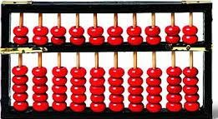
Historical Development of Computing
UNIVERSITY, KANO
www.buk.edu.ng
First calculating ‘machines’ were fingers, stones, beads, etc
Examples of counting aids from ancient civilizations includes
Greece: The Abacus (287BC)
Africa: decorated necklace and wrist bands
Peru: rows of knotted strings, etc
1st mechanical calculating machine was the Antikythera used by the ancient Greeks for astronomical calculations
Mechanical computation did not get going until the 17th century
Blaise Pascal, aged 19, invented a gear-based machine for addition and subtraction in 1642
In 1672, von Leibnitz added multiplication and division
Then came the Charles Babbage’s Difference Engine
Only addition and subtraction but with hard-copy output
Laid the foundation for 1st programmable mechanical computer
www.buk.edu.ng

Slide 20
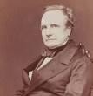
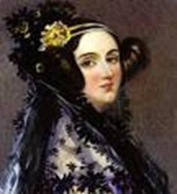
Historical Development of Computing
UNIVERSITY, KANO
www.buk.edu.ng
Charles Babbage’s Analytical Engine
The Store (Memory)
The Mill (CPU)
The Input section (punch card reader)
The Output (Punched cards)
Read instrs from punch cards and execute them
1st fully programmable yet fully mechanical
Programming was via a simple assembly language developed by Ada Lovelace
Never worked – the gears couldn’t be made accurate enough
www.buk.edu.ng

Slide 21
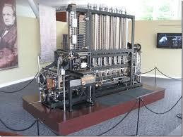
.
UNIVERSITY, KANO
www.buk.edu.ng
www.buk.edu.ng

Slide 22
.
UNIVERSITY, KANO
www.buk.edu.ng
First Electronic Computers
Babbage’s Analytical Engine laid the foundation
No significant advances until late 1930
Conrad Zuse used electronic relays to build an electronic computing machine
John Atanasoff invented a machine which used binary arithmetic and had a capacitor memory (now known as DRAM). Never worked
George Stibbitz demonstrated a working machine in 1940
Howard Aiken built Babbage’s analytical engine using electronic relays in 1944, and made it work.
www.buk.edu.ng

Slide 23
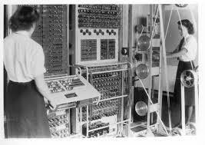
.
UNIVERSITY, KANO
www.buk.edu.ng
The Vacuum Tube Machines
Compelled by the necessity to crack the ENIGMA code, Alan Turing was commissioned by the British MoD to design the COLOSSUS
The world’s 1st electronic digital computer
Worked, but highly classified
Maulchy and Erkert build the ENIAC in 1943-46
18000 vacuum tubes, 1500 relays, 6000 programming switches, 30 tons
Influenced a host of similar machines
– EDSAC I, ILIAC, MANIAC, etc.
www.buk.edu.ng

Slide 24
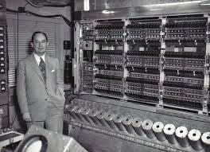
.
UNIVERSITY, KANO
www.buk.edu.ng
The von Newmann Machines
John von Newmann designed the 1st programmable electronic computer at IAS
The basic architecture for almost all modern machine follows the IAS design
www.buk.edu.ng

Slide 25
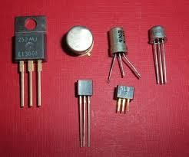
.
UNIVERSITY, KANO
www.buk.edu.ng
The Invention of Transistors
Shockley, Bardeen and Brittain invented the transistor in 1948, and won the 1956 Nobel Prize for Physics
Made vacuum tube machines obsolete from early 50s
Was very expensive: the DEC PDP-1 had 4K 18-bit word memory, a visual display, ran at 0.2MHz and cost $120,000.00
The PDP-8 later introduced the idea of a bus, to allow components to communicate with each other, rather than via the memory
The IBM 7090 dominated scientific computing in the 60s, while 1401 dominated the business market
www.buk.edu.ng

Slide 26
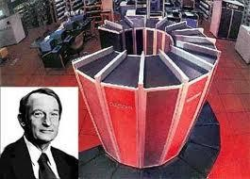
.
UNIVERSITY, KANO
www.buk.edu.ng
Seymour Cray
The 6600, designed by Seymour Cray was introduced by CDC in 1964
It was superscalar with multiple functional units tha worked in parallel
Contained smaller slave units that handled admin tasks, leaving
the CPU to crunch numbers
Decades ahead of anything else that existed
Cray later formed his own company manufacturing super computers
The IC Revolution
Invention of IC by Jack Kilby and others drove the next revolution
www.buk.edu.ng

Slide 27
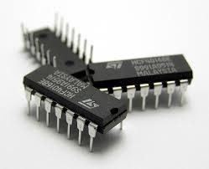
.
UNIVERSITY, KANO
www.buk.edu.ng
They figured out how to pack many transistors on a single microchip
Led to cheaper computers and ignited the microcomputer revolution in the 70s
notable machines included the IBM 360, suitable for both
scientific and commercial applications
_{– 1}st
computer featuring multiprogramming, allowing it to
run several programs at once and could also emulate other macines
www.buk.edu.ng

Slide 28
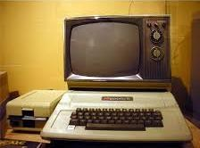
.
UNIVERSITY, KANO
www.buk.edu.ng
VLSI
IC-based micros where still very large
VLSI technology allow tens hundreds of millions of transistors to be fabricated on a single chip
Ignited the home computer revolution
Early home computers cost a few hundred pounds and were plugged into TV
They were mainly used for games, word processing and
spreadsheet
Commodore 64, Intel 8080, Zilog Z80, BBc Micro, etc
www.buk.edu.ng

Slide 29
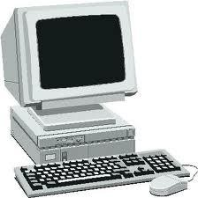
.
UNIVERSITY, KANO
www.buk.edu.ng
The PC
Intel 8088 CPU, MS-DOS operating system
Windows came much later (after Apple had introduced the GUI on the Lisa, and then the Mac)
IBM made the design public so that others could build add-ons
But others sold IBM-compatible
machines at much lower cost
Microsoft and Intel eventually gained control of the market created by IBM, and the result is the modern PC industry
www.buk.edu.ng

Slide 30
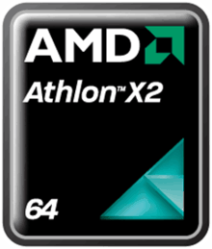
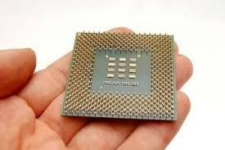
.
UNIVERSITY, KANO
www.buk.edu.ng
The Modern VLSI Microprocessors
The discerete-transistor machines of the 60s had a few thousand transistors which filled a large room
Early VLSI chips had a few tens
of thousands transistors
The modern Athlon 64 X2 has 221 million transistors on one microchip that is just 118mm² in area
The transistors are < 0.1microns in width
www.buk.edu.ng

Slide 31
The Stored Program Computer
UNIVERSITY, KANO
www.buk.edu.ng
Instruction vs. Data
Modern computers accomplish computations by interpreting and manipulating binary strings
Binary strings are either 4 or 8 bytes long in most machines (i.e. 32 or 64 bits)
A single 32- (or 64-) bits string is referred to as a word, which are of two types
Data: Numbers/ASCII letter codes that correspond to the variables/constants in our programs
Instructions: interpreted by the computer and used to control what
happens to the data
BOTH ARE STORED IN A SINGLE READ-WRITE MEMORY, ALTHO IN DIFF LOCATIONS
BOTH WORDS LOOK THE SAME BUT ARE PROCESSED DIFFERENTLY
BOTH CAN BE MANIPULATED USING DIGITAL LOGIC
Thus…
Bayero University, Kano - Nigeria
www.buk.edu.ng

Slide 32
A computer needs to be able to:
Manipulate data
Interpret instructions and decide what to do
Store words (both types)
Keep track of what is happening next
Get data/instructions in and out
Move data/instructions around
The core of modern computer where software is executed is the
CPU, which must be able to
Read the program and its data from some external device (memory)
Process instructions of the program in the correct order
Manipulate and compute with data in accordance with the instructions
Take decisions according to the results of the computations
Send the results of the computations to some external device (screen, printer) or store them for further use
.
UNIVERSITY, KANO
www.buk.edu.ng
Bayero University, Kano - Nigeria
www.buk.edu.ng

Slide 33
.
UNIVERSITY, KANO
www.buk.edu.ng
Typical CPU must therefore have units which can:
Load/store instruction and data in memory
Interpret the instructions to allow the machine to do the necessary computations
Program Counter
Load/Store Unit
Send the results to external devices
Take appropriate decisions and control what is happening
Keep track of things
Instr. Register
Control Unit
Registers
ALU
Bayero University, Kano - Nigeria
www.buk.edu.ng

Slide 34
.
UNIVERSITY, KANO
www.buk.edu.ng
Storage
Memory can, roughly, be divided into
Main memory
Used to store both instructions and data
Can hold whole programs and all their data
Generally physically separate from the main CPU and therefore slow
compared to the Registers
Registers
Used to store active instructions and data which are currently being used
Each register holds one word
Physically within the CPU, therefore very fast compared to MM
Some registers are special-purpose
» Instruction registers
» Program counters
Bayero University, Kano - Nigeria
www.buk.edu.ng

Slide 35
.
UNIVERSITY, KANO
www.buk.edu.ng
I/O
Computers are useless if there is no means of putting stuff in and getting stuff out
Most devices have some I/O controller which handles external devices
These controllers work in several ways
Assign the external devices some memory addresses
Use interrupts
Bayero University, Kano - Nigeria
www.buk.edu.ng

Slide 36
.
UNIVERSITY, KANO
www.buk.edu.ng
Bus
The transport network within a computer is known as the
bus
Consists of:
A set of wires down which information can be sent (instruction, data, addresses, control signal, etc)
A protocol which allows components to
Write info on to the bus for transmission to other components of the machine
Read info from the bus
Control where the info is being sent and what is reading it
A bus controller which
Grants/refuses access to the bus
Balances the use of the bus between components
Bayero University, Kano - Nigeria
www.buk.edu.ng

Slide 37
.
UNIVERSITY, KANO
www.buk.edu.ng
The von Neumann Design
CPU
MAIN MEMORY
LONG-TERM MEMORY
I/O & PERIPHERALS
THE BUS
Bayero University, Kano - Nigeria
www.buk.edu.ng

